Slide 1
“Art Author Detection”: identifying the artist from the art
AML1214 – Python Programming
Group Python Noobs:
Aishlee - C0913045
Bimal Kumar - C0919385
Danilo Diaz - C0889539
Ernie Sumoso - C0881591
Shivamkumar Patel - C0907758

Slide 2

Table of Contents
Problem
01
Dataset Description
Results
02
05
Project Overview
03
Convolutional Neural
Networks used
04
The problem that we are trying to solve with this project.
We explain why and how we used CNN’s
We describe de dataset used for test and training of our ML models
We show a demo of our web application.
How does it works? We give a general flow of our project

Slide 3
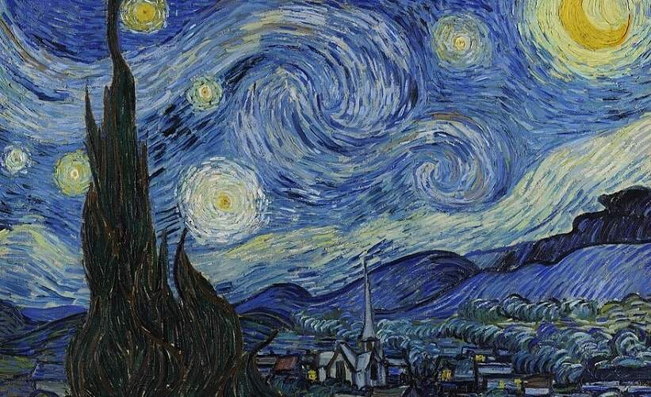

1. What problem are we trying to solve?
We are trying to solve the challenge of artist identification seeking to enhance accessibility to art knowledge by accurately associating artists’ names with their corresponding masterpieces.
Key solutions:
Help people learning artists' names
Help individuals to relate famous paintings to their authors
Diffusing art education

Slide 4

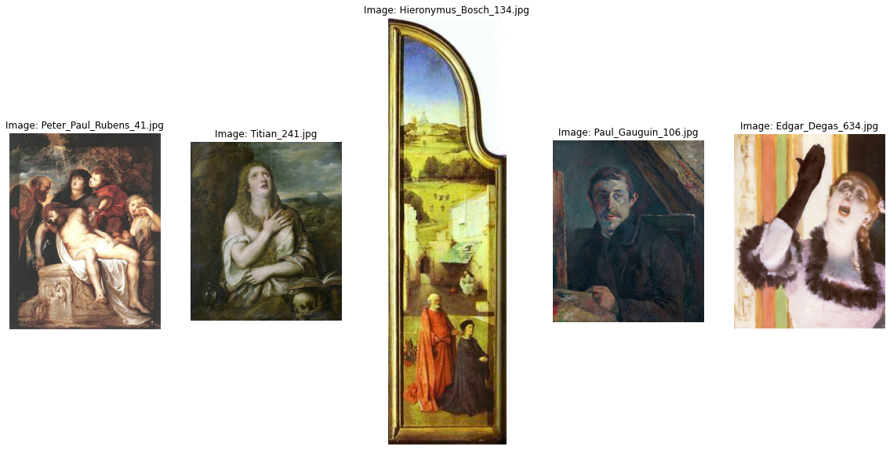
2. Dataset Description
Our dataset was extracted from Kaggle source.
It contains 8446 images (in JPG format) of famous paintings
from 50 most influential artists of all time.
The images are in both their original and resized formats.
The size of the entire dataset is > 2.2 GB.

Slide 5
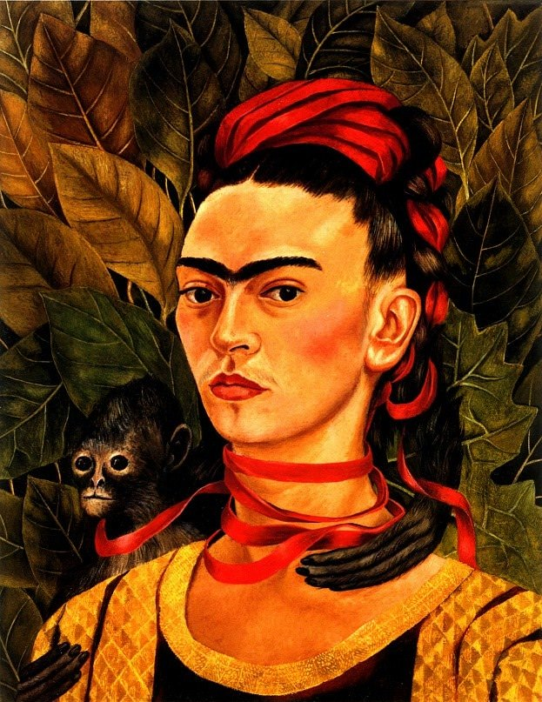

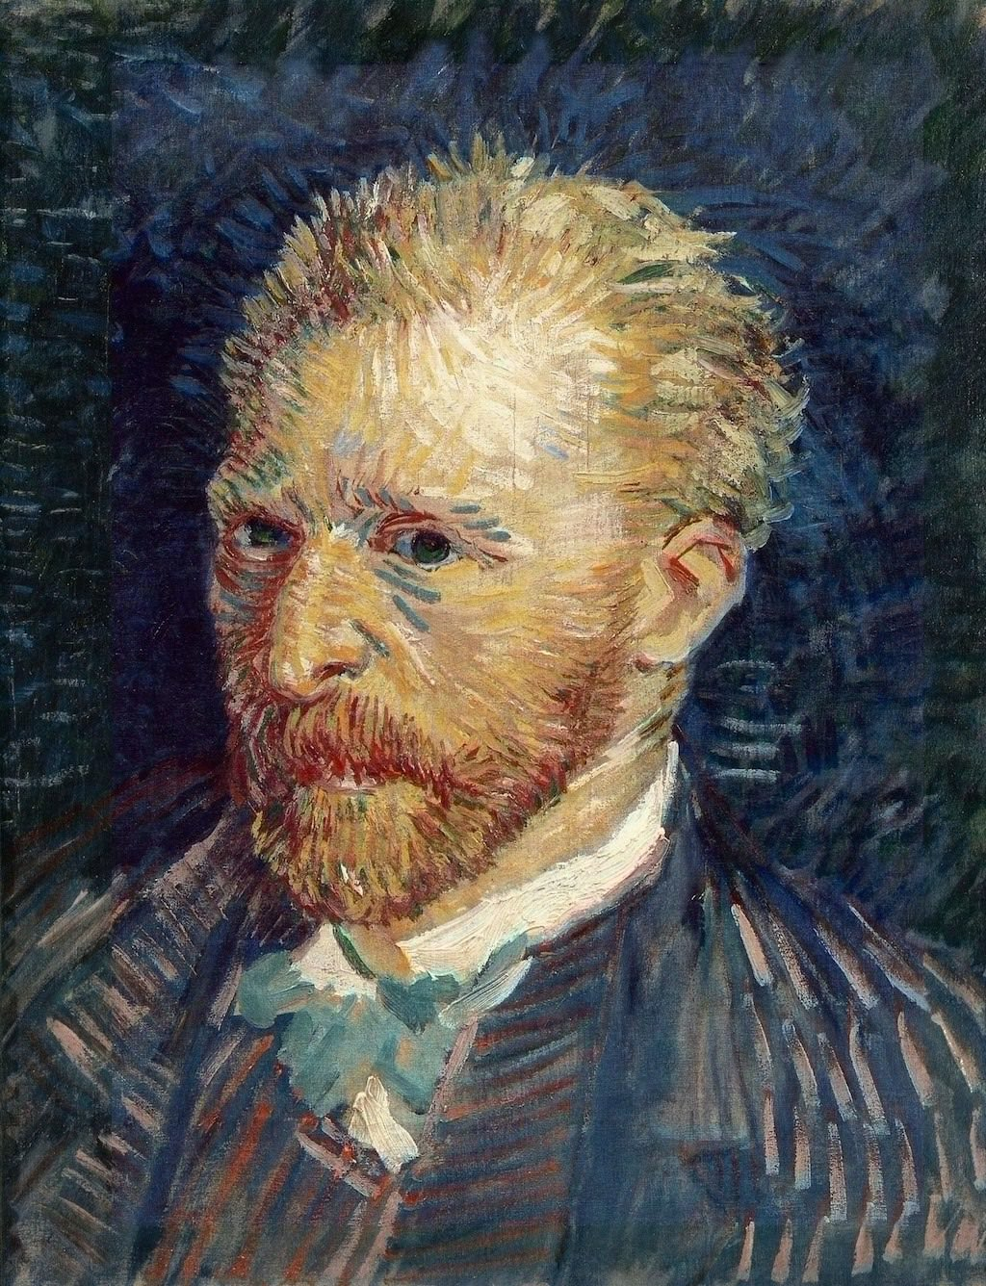
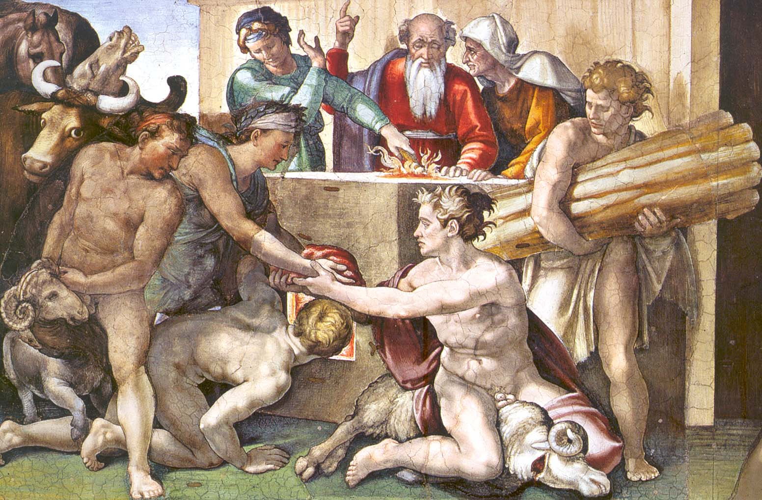
Some of the famous artists in our dataset:
Pablo Picasso
Frida Kahlo
Vincent Van Gogh
Michelangelo

Slide 6
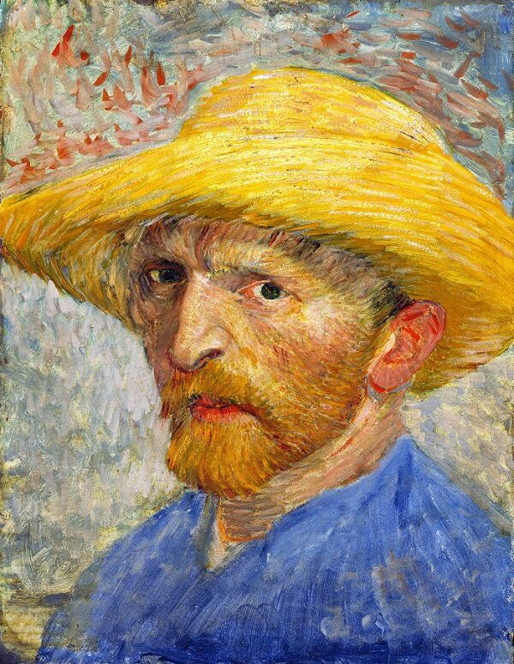


3. Project Overview
1. The user uploads an image to the web application front-end
2. The user selects one of the 2 models (VGG19 or ResNet50) for the prediction
3. The web application back-end receives the image for pre-processing (resizing and format)

Slide 7


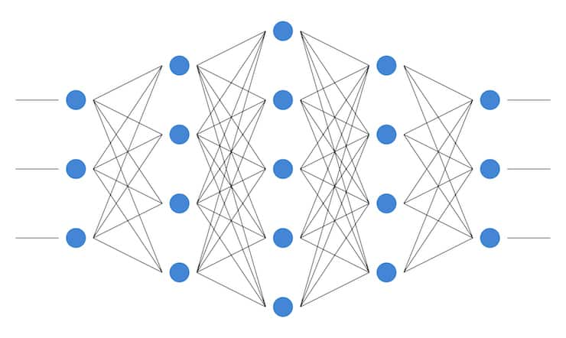

4. The selected CNN model (VGG19 or ResNet50) makes a prediction on the uploaded image, as they have already been trained.
5. As our model prediction is numerical, we need to map the number to an artist name, for this we use a JSON file.
6. Finally, the artist's name and the score (confidence in prediction) is sent to the front-end and displayed to the user.

Slide 8
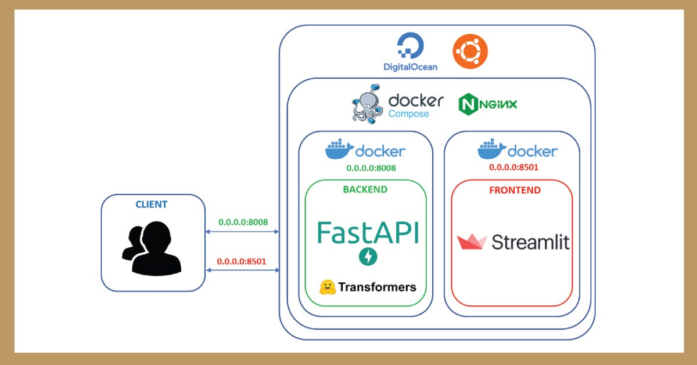
Web Application Architecture
We have used Streamlit (frontend) & FastAPI (backend) to build our web application front-end and back-end.
Both are Python frameworks to build short-scoped but powerful projects.
We also build and run our project in a Docker container.

Slide 9
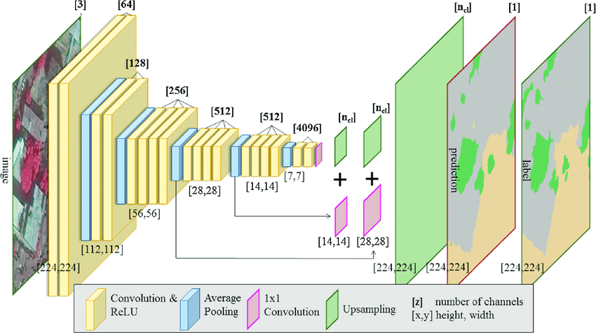
4. Convolutional Neural Networks used
We decided to use 2 CNNs for this project.
VGG-19: convolutional neural network with 19 layers deep.
Pre-trained on over a million images from the ImageNet database.
Can classify images into 1000 object categories
The network can learn feature-rich representations from a wide range of images.
Image input size is 224x224 pixels.

Slide 10
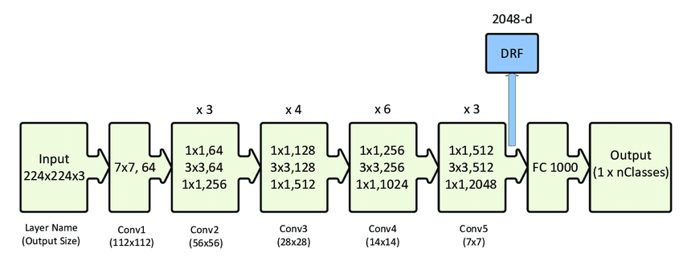
4. Convolutional Neural Networks used
ResNet50: convolutional neural network with 50 layers deep.
Similarly to the VGG-19 model:
Pre-trained on over a million images from the ImageNet database.
Can classify images into 1000 object categories
Image input size is 224x224 pixels x3 colors (RGB).
Accuracy score with our dataset: 0.58

Slide 11
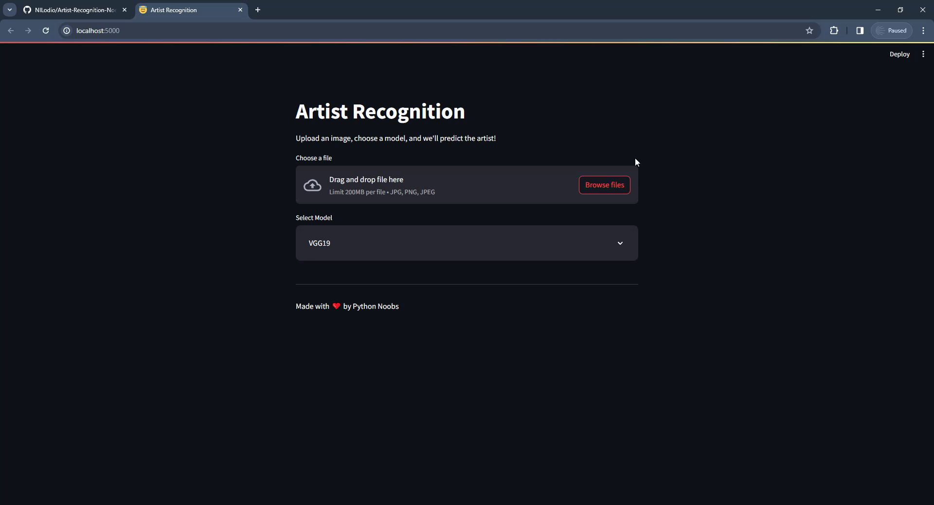
5. Results
Let’s take a look to our web application in the following video:

Slide 12

6. Conclusions
Based on the results we conclude:
Our models successfully predicted artists name with a score of approximately 60%.
This means that multiple paintings can be predicted accurately to:
Diffuse art education, relate most famous artists with their art pieces, and help people learn artists names
For future projects we could add more images to our dataset: test and train subsets.
We can also improve our model’s accuracy by testing different network architectures and parameters.
Some artists like Frida Kahlo and Pablo Picasso, have higher prediction confidence as their painting styles are very unique.

Slide 13
References
Kaggle - Best Artworks of All Time
https://www.kaggle.com/datasets/ikarus777/best-artworks-of-all-time/data
Github - Artist-Recognition-Noobs
https://github.com/NILodio/Artist-Recognition-Noobs/tree/develop
Python Official Documentation
https://www.python.org/
FastAPI Official Documentation
https://fastapi.tiangolo.com/
Streamlit Official Documentation
https://docs.streamlit.io/
Deploying Machine Learning models with Streamlit, FastAPI and Docker
https://rihab-feki.medium.com/deploying-machine-learning-models-with-streamlit-fastapi-and-docker-bb16bbf8eb91

